Slide 1

Ebola Outbreak North-Kivu 2018 Risk of Future Cases
Srinivasan Venkatramanan, Bryan Lewis, and Alex Telionis
on behalf of the
Network Systems Science & Advanced Computing Division
Biocomplexity Institute & Initiative
University of Virginia

Slide 2
Approach
Data and methods used:
Updated Population and Health Zone data
Metapopulation transmission model with human mobility for transmission projection
Case counts as reported by DRC Ministry of Health
International risks estimated for Port of Entry data (cleaned)
Results:
Risk of future cases within the DRC
Yet to be done - Risk of arriving cases at international ports of entry

Slide 3
Datasets
Updated Population for the DRC gathered from Humanitarian Data Exchange: https://data.humdata.org/dataset/rdc-statistiques-des-populations
Update Health Zone maps via Humanitarian Data Exchange: https://data.humdata.org/dataset/democratic-republic-of-congo-health-boundaries
River Network and Road Networks via Digital Chart of the World (DCW): diva-gis.org
Combined into a single coherent travel network with novel methodology (in preparation) for travel time calculations to feed mobility model
DRC Ministry of Health as curated by Sophie Meakin: https://github.com/sophiemeakin/ebola_drc/

Slide 4
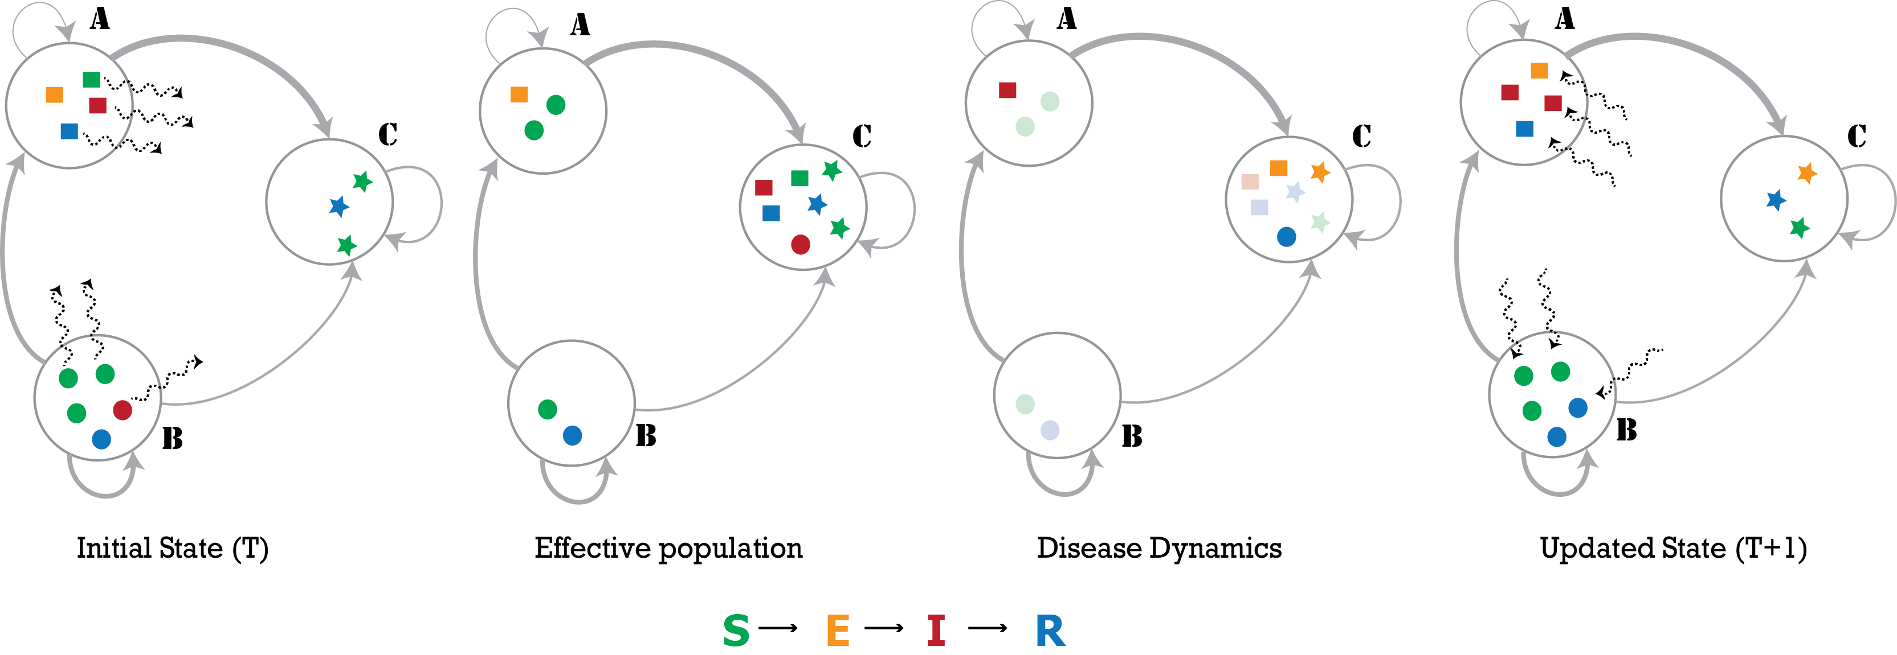
Model Description
PatchSim: Metapopulation model with gravity mobility model
The large circles represent the patches (A,B,C) in the simulation, and the grey edges represent the travel network, colors represent the disease state the individuals are in (susceptible, exposed, infected or recovered), The wavy dashed arrows show movement of individuals. Panel 1. Individuals move moved from home to another patch. Panel 2. This creates another effective population where the disease dynamics operate and individuals become ill (change from green to red) which stand out in the 3rd panel. Panel 4. Finally, the individuals return to their home patch
Notes:
The large circles represent the patches in the simulation, and the grey edges represent the
travel network, with varying thickness denoting heterogeneity in flow volumes. The sample
population shows 4 individuals in patch A (squares), 5 in patch B (circles) and 3 in patch
C (stars). The colors represent the disease state the individuals are in (susceptible, exposed,
infected or recovered). The wavy dashed arrows show movement of individuals (randomly
chosen according to outgoing edge probabilities). In the first step, individuals are moved from
their home patch to another patch (first panel), creating the effective population (second panel).
The disease dynamics may constitute an exposure event (transition from S to E), onset of
infectiousness (E to I), or recovery event (I to R). The nodes undergoing these transitions are
highlighted in third panel, where we see an onset of infectiousness in patch A, two exposures
and a recovery in patch C. Finally, the individuals return to their home patch (fourth panel).

Slide 5
Calibration Approach
DRC Health ministry case reports used as ground truth
Vaccinations and surging case reports used to adjust healthzone specific forces of infection to closely match ground truth

Slide 6
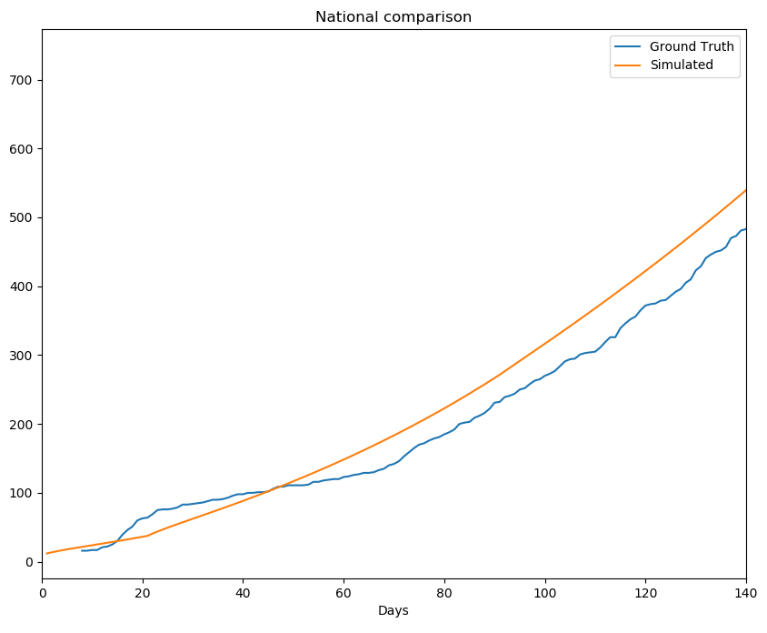
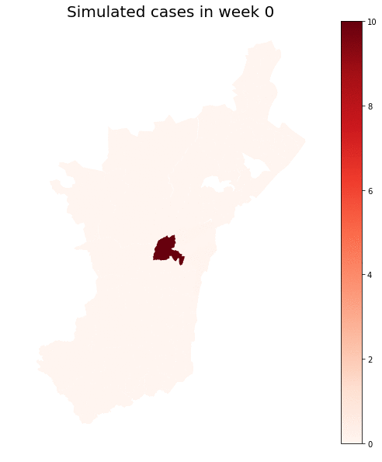
Calibration – National Level
* suspect Oicha ground truth may be undercounted by WHO due to security problems

Slide 7
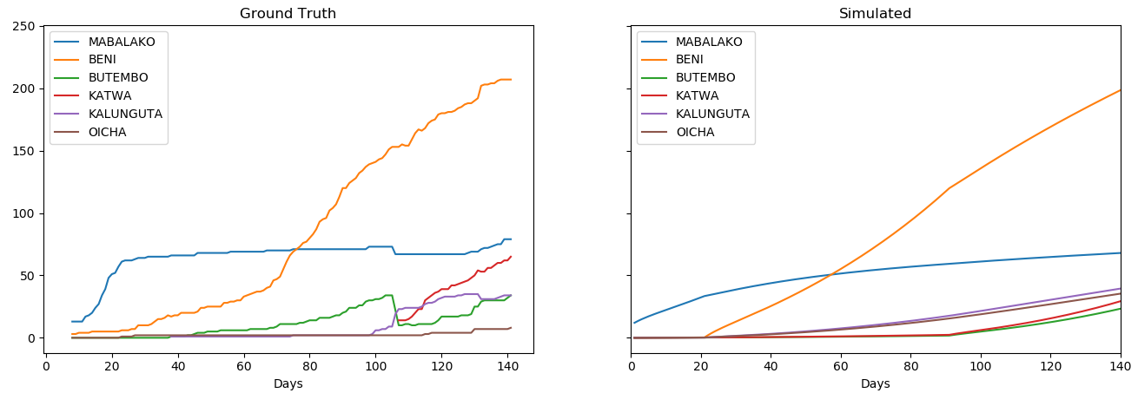
Calibration
* suspect Oicha ground truth may be undercounted by WHO due to security problems

Slide 8
Risk Calculations
Future Cases: Proportion of future cases generated by running calibrated model beyond the last “observation” 30 days into the future
Examine 2 scenarios for the future:
Scenario 1: Current controls remain in place in the healthzones they’ve been employed
Scenario 2: All control efforts are released on the date of last observation
Yet to be done: International ports of entry: Risk of future cases arriving at ports of entry

Slide 9
Results – Scenario 1 Healthzone risk (controls remain)
Likely locations of future cases in the next 30 days
Estimated future cases beyond current state
35% more cases 30 days out
74% more cases 60 days out
116% more cases 90 days out
Health Zone | Risk Index
BENI | 20.5%
KATWA | 13.2%
BUTEMBO | 10.3%
KALUNGUTA | 6.7%
OICHA | 6.7%
MUTWANGA | 3.3%
MABALAKO | 2.2%
MUSIENENE | 2.1%
KYONDO | 2.1%
LUBERO | 2.0%

Slide 10
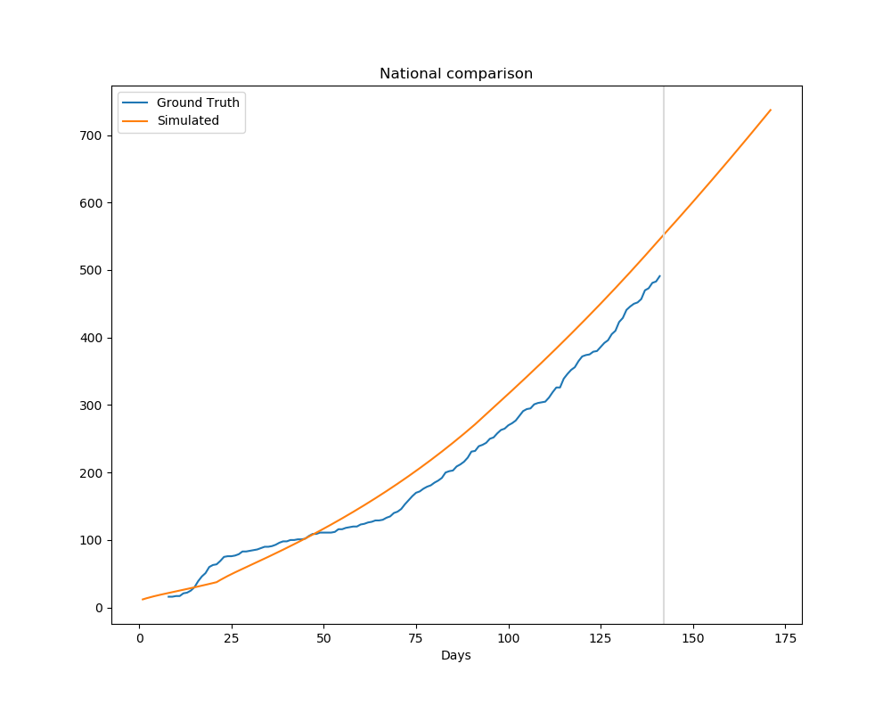
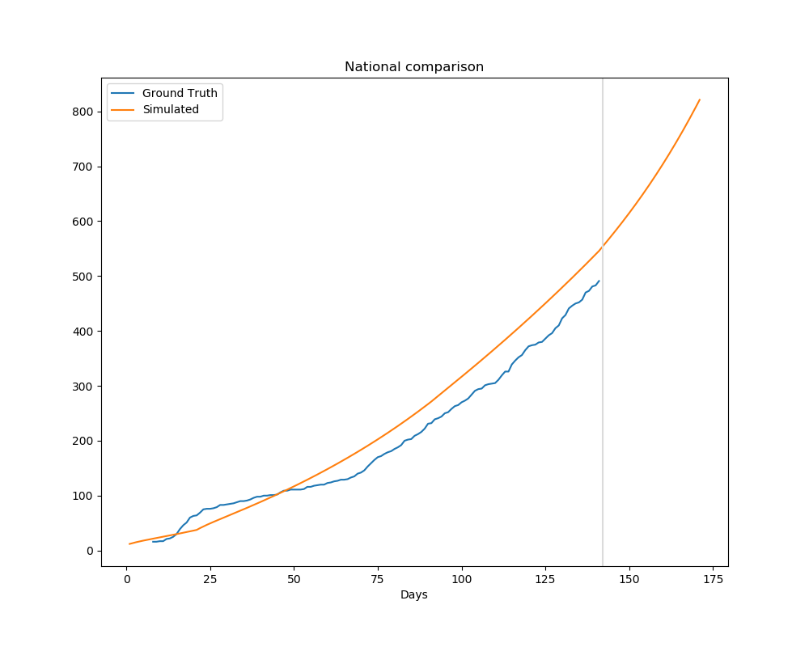
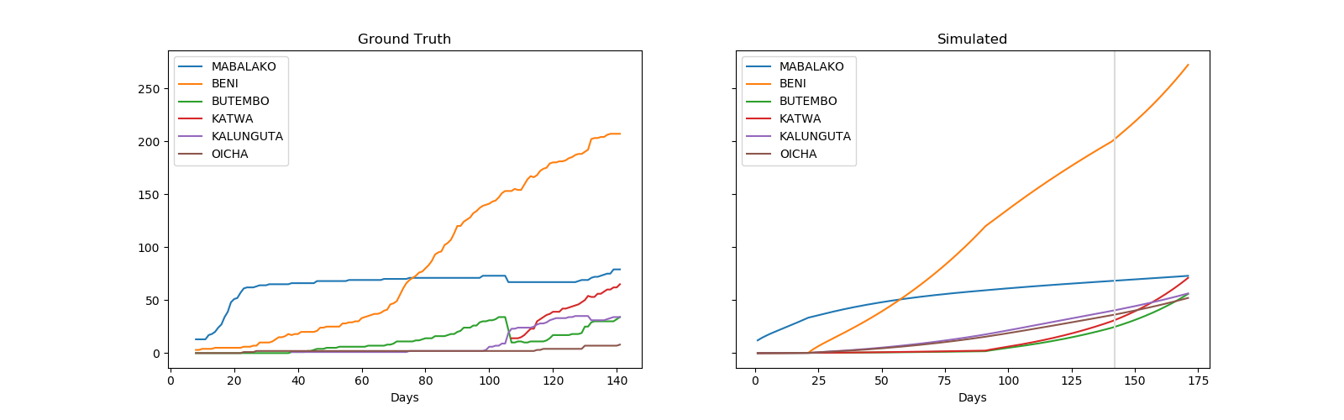
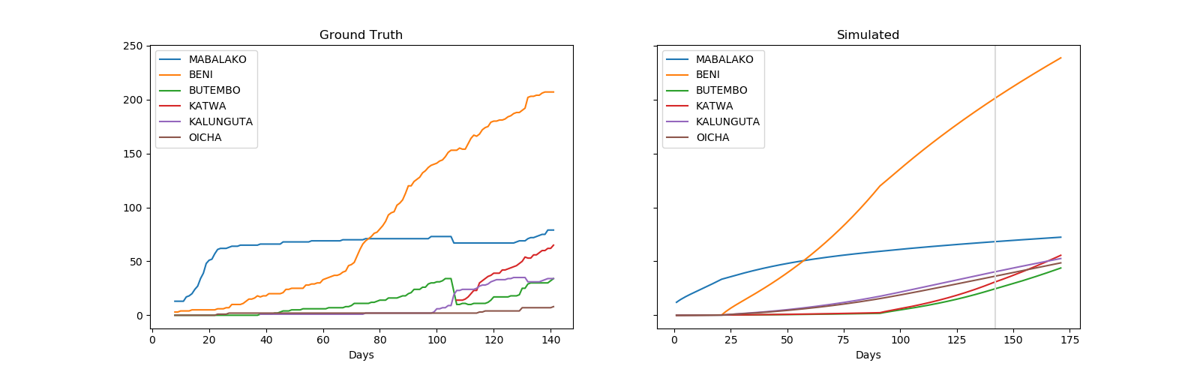
Results – Scenario 1 Healthzone risk (controls remain)

Slide 11
Results – Scenario 2 Healthzone risk (control efforts removed)
Likely locations of future cases in the next 30 days
Compared to controls remaining in place how many more cases to expect
11.3% at 30 days out
36.5% at 60 days out
81% at 90 days out
Should controls remain removed for 90 days there could be roughly 81% more cases than if controls remained in place (roughly 1000 cases)
Health Zone | Risk Index
BENI | 26.2%
KATWA | 14.6%
BUTEMBO | 11.4%
KALUNGUTA | 6.0%
OICHA | 6.0%
MUTWANGA | 2.9%
MUSIENENE | 1.9%
KYONDO | 1.8%
MABALAKO | 1.8%
LUBERO | 1.8%

Slide 12
Results – Scenario 2 Healthzone risk (control efforts removed)

Slide 13
Yet to be completed Port of Entry calculations

Slide 14
Port of Entry methods
Ports of Entry identified and matched to existing data (WHO sitreps and POE from Humanitarian data exchange)
Weights assigned by matched average daily traveler information
Exposure to future cases calculated through mobility model based on road-river network travel times.

Slide 15
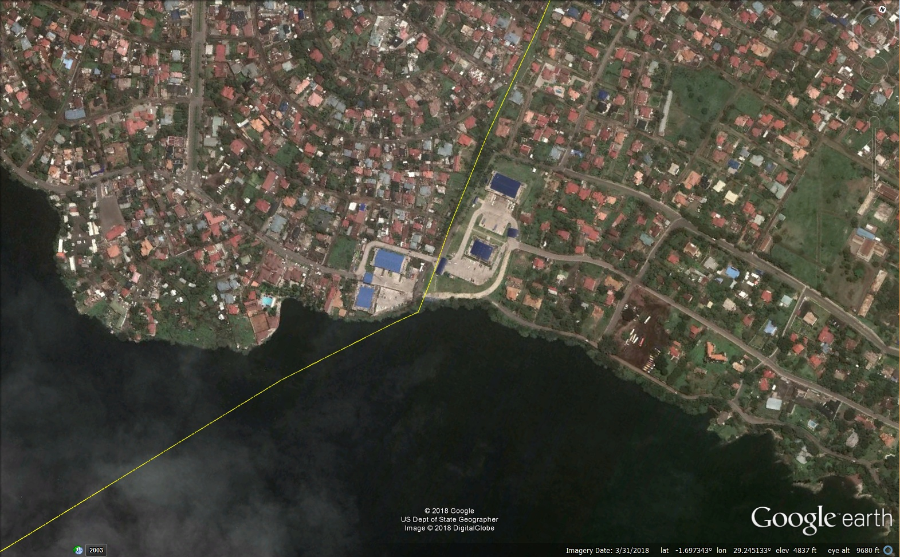
Major Border Crossing
Visible Population Center
Major Road
Visible Border Control (!)

Slide 16
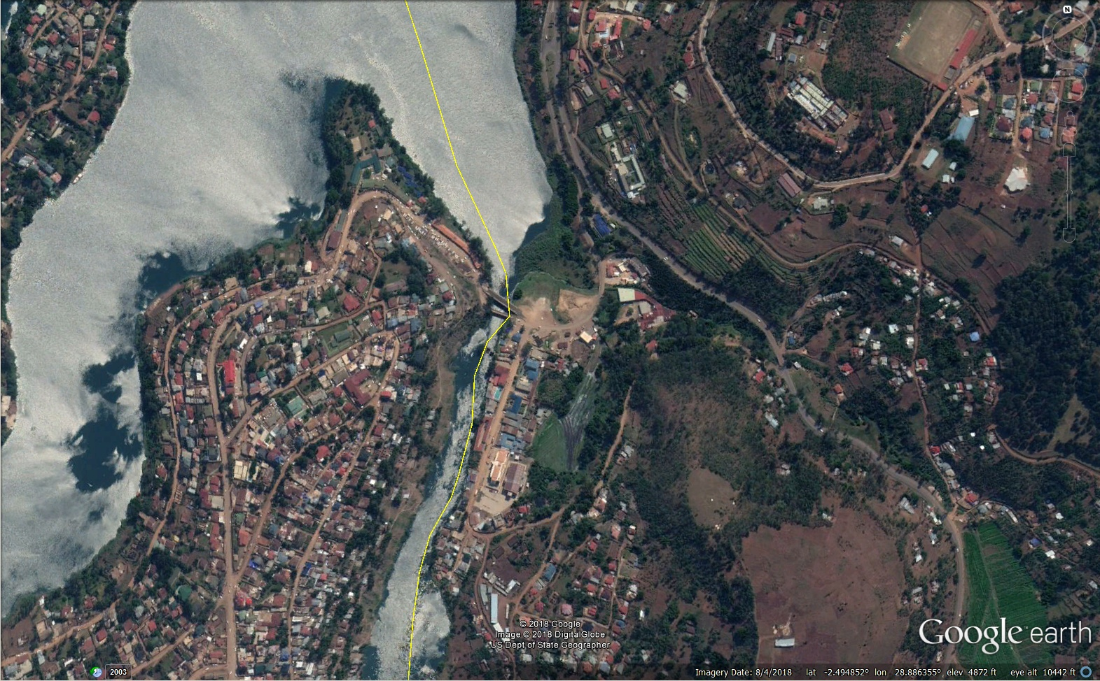
Mid-sized Border Crossing
Visible Population Center
Major Road
No Obvious Border Control

Slide 17
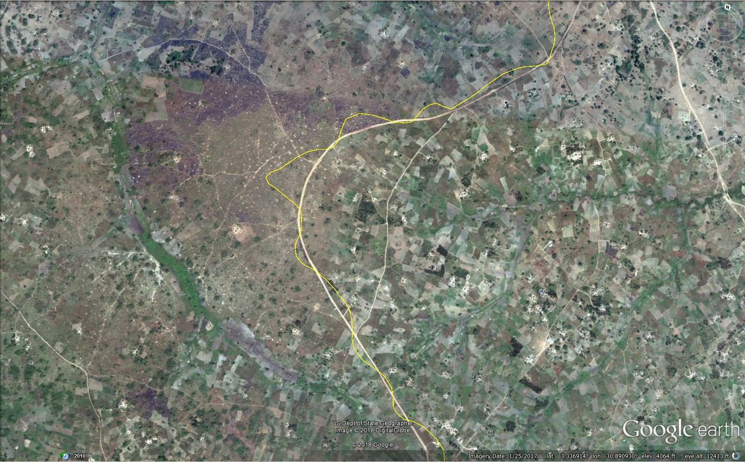
Minor Crossing (Not Included)
Sparse Population
Minor Road
Meanders Across Border

Slide 18
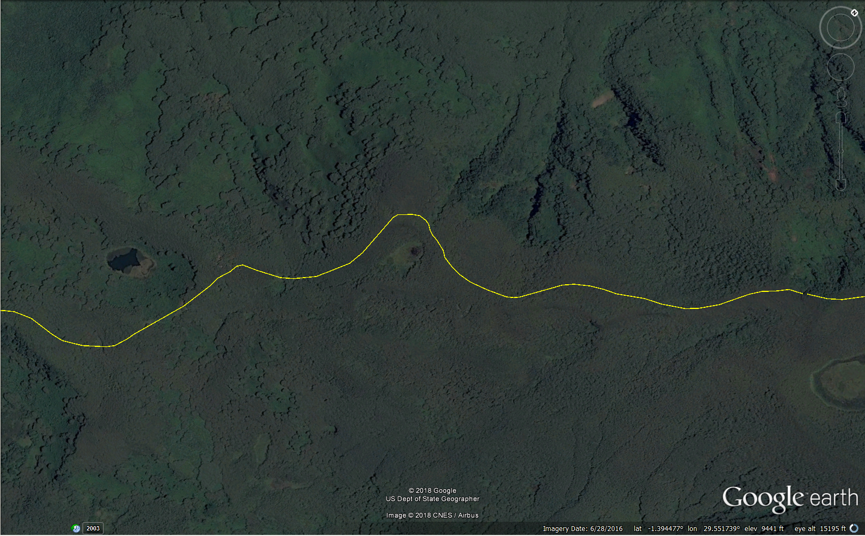
No Visible Crossing

